Slide 1
The PyPy Sandbox
Using the PyPy Sandbox to Explore Mobile Code Sandboxing

Slide 2
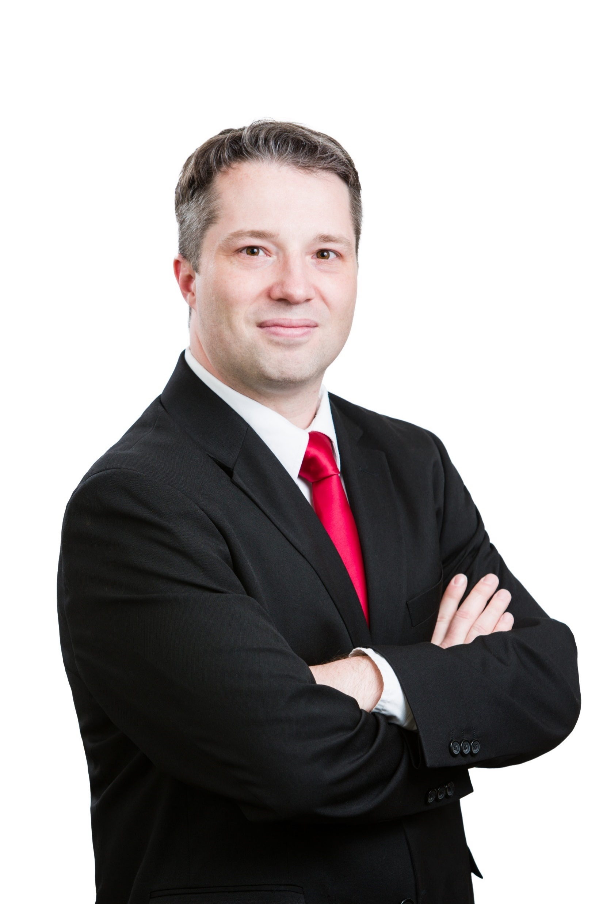
Seth James Nielson
B.S./M.S. Computer Science from Brigham Young University
Ph.D. Computer Science from Rice University
Past Experience: Software Engineer, Security Analyst
Director of Advanced Research Projects at
The Johns Hopkins University Information Security Institute
Founder, Chief Scientist, Crimson Vista Inc.

Slide 3
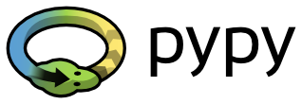
The PyPy Sandbox (An Introduction)
The PyPy Project
Replacement for Cpython
Faster execution of most Python code
Current versions: 2.7.13 and 3.5.3
The PyPy Sandbox is a Secondary Feature
Execution of untrusted Python scripts

Slide 4
The Problem with Computers
Computer processors do exactly what they’re told
They have no ability to decide if they should do what they’re told
What if they’re told to do something harmful?
A lot of technology goes into figuring out what should be done
Operating System
Anti-virus
Device permissions

Slide 5
A Sandbox:
The concept of a sandbox is an environment where destruction doesn’t matter
In practice, it is an interceptor between applications and the OS
The interception layer enables:
Policy Enforcement
“Sensor” Translations
“Command” Translations

Slide 6
Untrusted
Application
SANDBOX
Operating System
Services
(Network, Filesystem, etc)

Slide 7
Policy Enforcement
Most common use of a Sandbox
Each incoming request to the operating system, and response, can be inspected
Requests and responses can be allowed, denied, or modified
Policy based on request/response type, parameters, state of the system, etc
Examples:
Network Access (Deny, Same-Origin Policy)
File Access (Read Only, Write-to-Temp)
Even memory allocations

Slide 8
Sensor/Command Translations
Policy is not just about allow/deny but rewrite/modify
Any risky call (e.g., syscall) can be rewritten with safer parameter
(Or a risky call could be re-written to a safer call with similar semantics)
But a sometimes overlooked Sandbox capability is lightweight virtualization
I like to call this “Sensor” translations
The Sandbox can control what the application “sees”
For example, it can present a virtual filesystem
Or provide alternative API replacements that are more secure

Slide 9
Untrusted
Application
Virtual Filesystem
SANDBOX
Operating System
Services
(Network, Filesystem, etc)
On-disk Filesystem

Slide 10
The PyPy Sandbox
Creates a limited PyPy Interpreter
No direct calls to the OS (system calls, etc)
Does not allow dynamic libraries, including compiled Python modules
Instead, a controlling process receives OS calls marshalled over a pipe
This process provides the sandboxing and enforces security policies
For permitted calls, it performs the call itself and sends back the result
Or, it can modify the request and/or results

Slide 11
Controlling Process (Sandbox)
PyPy Sandbox Interpreter
Untrusted Python
Script
(optional)
Operating System
Services
(Network, Filesystem, etc)

Slide 12
Infinite Variety of Sandboxes
Different controlling processes create different kinds of sandboxes
Controlling process does not have to be Python
The PyPy project provides a default controlling process called “pypy_interact.py”
Can run a python “shell” or execute a script
Many OS subsystems completely disabled including network operations
Read only virtual file system
/bin – virtual bin directory with pypy and a few required directories
/tmp – temp directory that potentially maps to a real directory
NOTE: the interpreter lives in the sandbox and executes the script from virtual /tmp!

Slide 13

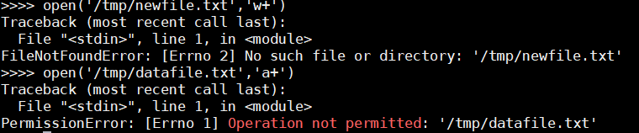

Slide 14
Running an Untrusted Script
Contents of “dangerous_script.py”
import os
print("Script Current Working Dir: {}".format(os.getcwd()))
print("Contents of root dir: {}".format(os.listdir('/')))
print("Try to delete /tmp dir with a system call.")
os.system('rm -rf /tmp')

Slide 15
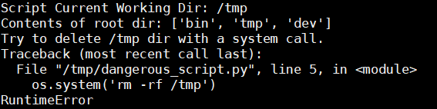

Slide 16
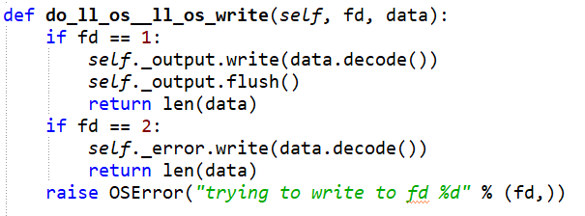
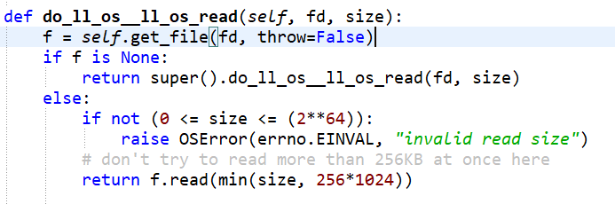
Sample Sandboxing Functions

Slide 17
Using PyPy in the Classroom
Network Security at Johns Hopkins University
Student Labwork:
Uses “Playground,” an education overlay network created by the Author
Students create their own version of TCP within Playground
Students create their own version of TLS within Playground
Students build mobile code applications on top of Playground using PyPy
Parallel processing (e.g., Traveling Salesman)
Adapt pypy_interact to support new features (writing to filesystem)

Slide 18
Modifying pypy_interact
Requires students to carefully think about sandbox policies and features
For example, implementing write
Requires students to understand virtual file system
Implement policy for when writes are allowed
Specific directories
Maximum size
Argument sanitation (e.g., “../../..” doesn’t escape the sandbox)
Another example: implementing network operations

Slide 19
Developing Bot Brains
Advanced Network Security
“CyberWar_EDU” project
Gameboard with semi-autonomous “bots”
Students can (re-)program the bots with a Python brain script
Each brain scripts run inside a PyPy sandbox instance
Each brain needs to connect to
The Game Board (over TCP)
The Student’s command and control server (over Playground’s network)

Slide 20
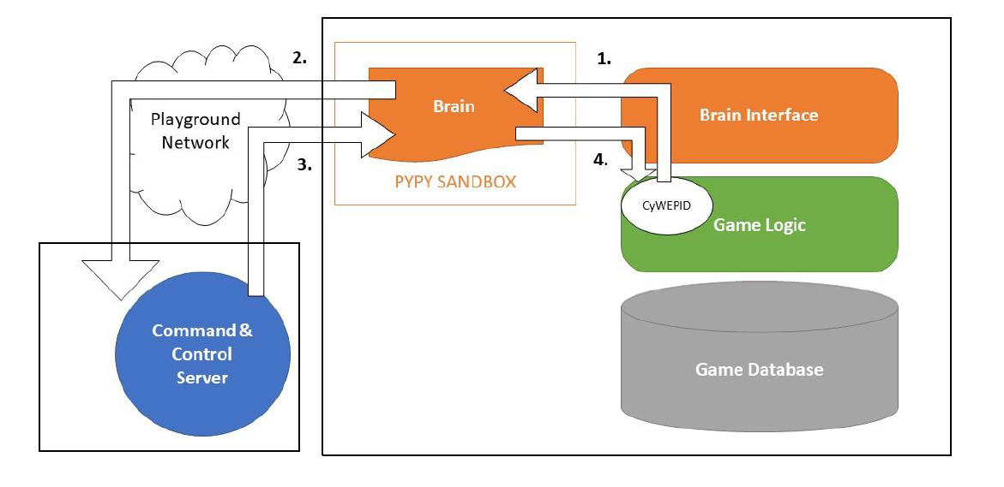

Slide 21
Sandbox “Brain” Extensions
Extended pypy_interact.py to brain_interact.py
Virtual file system supports two special virtual files:
“game://” which opens a socket to the gameboard
“<playground-protocol>://<host>:<port>” which connects to C&C
Allows writing within the /tmp directory so students can re-program their brains!

Slide 22
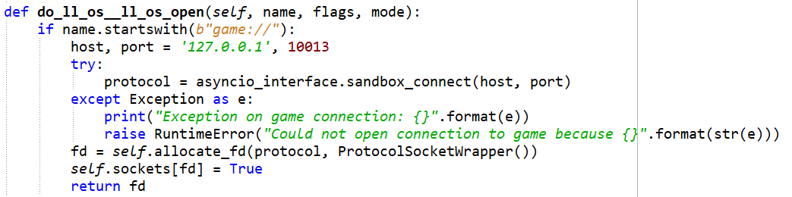
Sample Modified Sandbox Functions

Slide 23
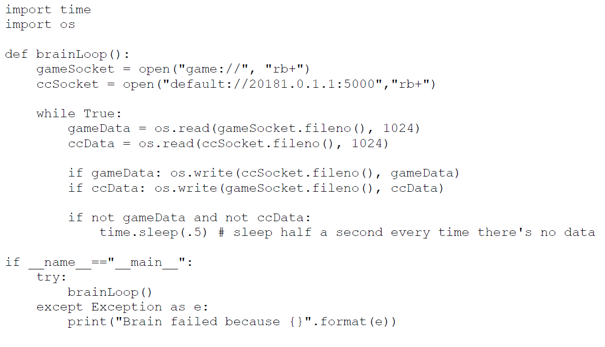
The “Null” Brain

Slide 24
Eventual Goal for Lab Work
Students reprogram bots over the network
Students attempt to reprogram other student bots to take them over
Eventually, want a student sandbox within the bot sandbox
Bot sandbox is to protect the game from student malicious code
Student sandbox is to protect bot against false reprogramming
Give students a chance to create “firmware” that detects bad “software”

Slide 25
Quick Review
PyPy sandbox
Provides lightweight Python sandboxing
A modified interpreter has no system calls
Dangerous calls are processed by a controlling process
Policy enforces allow, deny, and modify
Modify can be used to create a virtual system
Students can experiment extensively and gain insight into mobile code execution

Slide 26
Final Notes
PyPy sandbox is a prototype. It is not ready for production code
The current PyPy sandbox is somewhat broken for 2.7, inoperable for 3.5
For my class, I fixed 3.5. I plan to submit my changes to PyPy shortly
I have discussed providing on-going maintenance with the PyPy team

Slide 27
Thank You!
Feel free to ask questions!
Links:
The PyPy project: http://pypy.org
Playground code: https://github.com/CrimsonVista/Playground3
CyberWar EDU code: https://github.com/CrimsonVista/cybersecurity-war
Playground paper: https://eric.ed.gov/?id=EJ1132824
JHUISI: https://isi.jhu.edu/

